Slide 1
Introduction to Automata Theory
Reading: Chapter 1

Slide 2
What is Automata Theory?
Study of abstract computing devices, or “machines”
Automaton = an abstract computing device
Note: A “device” need not even be a physical hardware!
A fundamental question in computer science:
Find out what different models of machines can do and cannot do
The theory of computation
Computability vs. Complexity

Slide 3
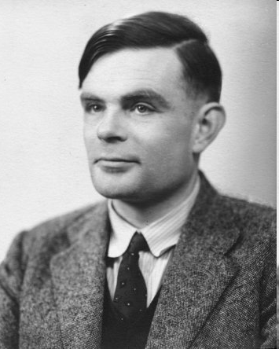
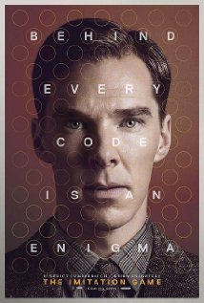
Alan Turing (1912-1954)
(A pioneer of automata theory)
Father of Modern Computer Science
English mathematician
Studied abstract machines called Turing machines even before computers existed
Heard of the Turing test?

Slide 4
Theory of Computation: A Historical Perspective
1930s
Alan Turing studies Turing machines
Decidability
Halting problem
1940-1950s
“Finite automata” machines studied
Noam Chomsky proposes the “Chomsky Hierarchy” for formal languages
1969
Cook introduces “intractable” problems or “NP-Hard” problems
1970-
Modern computer science: compilers, computational & complexity theory evolve

Slide 5
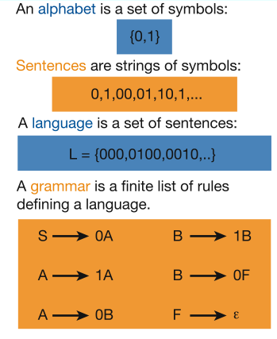
Languages & Grammars
Languages: “A language is a collection of sentences of finite length all constructed from a finite alphabet of symbols”
Grammars: “A grammar can be regarded as a device that enumerates the sentences of a language” - nothing more, nothing less
N. Chomsky, Information and Control, Vol 2, 1959
Or “words”
Image source: Nowak et al. Nature, vol 417, 2002

Slide 6
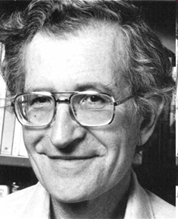
The Chomsky Hierachy
A containment hierarchy of classes of formal languages
Recursively- enumerable (TM)
Context- sensitive (LBA)
Context- free
(PDA)
Regular
(DFA)

Slide 7
The Central Concepts of Automata Theory

Slide 8
Alphabet
An alphabet is a finite, non-empty set of symbols
We use the symbol ∑ (sigma) to denote an alphabet
Examples:
Binary: ∑ = {0,1}
All lower case letters: ∑ = {a,b,c,..z}
Alphanumeric: ∑ = {a-z, A-Z, 0-9}
DNA molecule letters: ∑ = {a,c,g,t}
…

Slide 9
Strings
A string or word is a finite sequence of symbols chosen from ∑
Empty string is ε (or “epsilon”)
Length of a string w, denoted by “|w|”, is equal to the number of (non- ε) characters in the string
E.g., x = 010100 |x| = 6
x = 01 ε 0 ε 1 ε 00 ε |x| = ?
| ε | = 0
xy = concatentation of two strings x and y
00 concate10 = 0010
10 concate 00 = 1000

Slide 10
Powers of an alphabet
Let ∑ be an alphabet.
∑^{k} = the set of all strings of length k
∑* = ∑⁰ U ∑¹ U ∑² U … * = Kleene Closure (Closure)
{0,1}* = {ε, 0, 1, 00, 01, 10, 11,..}
∑⁺ = ∑¹ U ∑² U ∑³ U … + = positive closure
{0, 1}⁺ = {0, 1, 00, 01, 10, 11,..}

Slide 11
Languages
L is a said to be a language over alphabet ∑, only if L ⊆ ∑*
➔ this is because ∑* is the set of all strings (of all possible length including 0) over the given alphabet ∑
Examples:
Let L be the language of all strings consisting of n 0’s followed by n 1’s: L = {ε, 01, 0011, 000111,…} ⊆ {0,1}*
Let L be the language of all strings of with equal number of 0’s and 1’s:
L = {ε, 01, 10, 0011, 1100, 0101, 1010, 1001,…}
Definition: Ø denotes the Empty language
Let L = {ε}; Is L=Ø?
Canonical ordering of strings in the language
NO

Slide 12
The Membership Problem
Given a string w ∈∑*and a language L over ∑, decide whether or not w ∈L.
∑ = {0,1}, ∑* = {0,1}* = {ε, 01, 0011, 000111,…}
w = 011, L = ∑² = {00, 01, 10, 11}
w ∈ L ? Bukan; w= 00 w ∈ L ? Ya
Example:
Let w = 100011
Q) Is w ∈ the language of strings with equal number of 0s and 1s?
Q) w = 01001 ? Maka w∉ L (the language of strings with equal number of 0s and 1s)

Slide 13
Finite Automata
Some Applications
Software for designing and checking the behavior of digital circuits
Lexical analyzer of a typical compiler
Software for scanning large bodies of text (e.g., web pages) for pattern finding
Software for verifying systems of all types that have a finite number of states (e.g., stock market transaction, communication/network protocol)

Slide 14
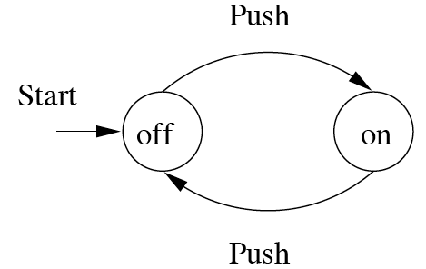
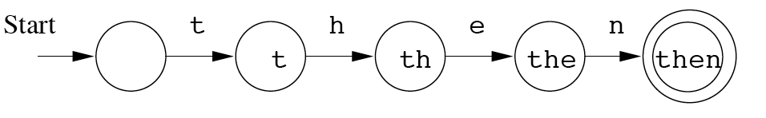
Finite Automata : Examples
action
On/Off switch
Modeling recognition of the word “then”
state
Start state
Transition
Intermediate state
Final state

Slide 15
Structural expressions
Grammars
Regular expressions
E.g., unix style to capture city names such as “Palo Alto CA”:
[A-Z][a-z]*([ ][A-Z][a-z]*)*[ ][A-Z][A-Z]
Start with a letter
A string of other letters (possibly empty)
Should end w/ 2-letter state code
Other space delimited words (part of city name)

Slide 16
Formal Proofs

Slide 17
Deductive Proofs
From the given statement(s) to a conclusion statement (what we want to prove)
Logical progression by direct implications
Example for parsing a statement:
“If y≥4, then 2^{y}≥y².”
(there are other ways of writing this).
given
conclusion

Slide 18
Example: Deductive proof
Let Claim 1: If y≥4, then 2^{y}≥y².
Let x be any number which is obtained by adding the squares of 4 positive integers.
Claim 2:
Given x and assuming that Claim 1 is true, prove that 2^{x}≥x²
Proof:
Given: x = a² + b² + c² + d²
Given: a≥1, b≥1, c≥1, d≥1
➔ a²≥1, b²≥1, c²≥1, d²≥1 (by 2)
➔ x ≥ 4 (by 1 & 3)
➔ 2^{x} ≥ x² (by 4 and Claim 1)
“implies” or “follows”

Slide 19
On Theorems, Lemmas and Corollaries
We typically refer to:
A major result as a “theorem”
An intermediate result that we show to prove a larger result as a “lemma”
A result that follows from an already proven result as a “corollary”
An example:
Theorem: The height of an n-node binary tree is at least floor(lg n)
Lemma: Level i of a perfect binary tree has 2^{i} nodes.
Corollary: A perfect binary tree of height h has 2^{h+1}-1 nodes.

Slide 20
Quantifiers
“For all” or “For every”
Universal proofs
Notation=
“There exists”
Used in existential proofs
Notation=
Implication is denoted by =>
E.g., “IF A THEN B” can also be written as “A=>B”

Slide 21
Proving techniques
By contradiction
Start with the statement contradictory to the given statement
E.g., To prove (A => B), we start with:
(A and ~B)
… and then show that could never happen What if you want to prove that “(A and B => C or D)”?
By induction
(3 steps) Basis, inductive hypothesis, inductive step
By contrapositive statement
If A then B ≡ If ~B then ~A

Slide 22
Proving techniques…
By counter-example
Show an example that disproves the claim
Note: There is no such thing called a “proof by example”!
So when asked to prove a claim, an example that satisfied that claim is not a proof

Slide 23
Different ways of saying the same thing
“If H then C”:
H implies C
H => C
C if H
H only if C
Whenever H holds, C follows

Slide 24
“If-and-Only-If” statements
“A if and only if B” (A <==> B)
(if part) if B then A ( <= )
(only if part) A only if B ( => ) (same as “if A then B”)
“If and only if” is abbreviated as “iff”
i.e., “A iff B” “A jik-ka B”
Example:
Theorem: Let x be a real number. Then floor of x = ceiling of x if and only if x is an integer.
Proofs for iff have two parts
One for the “if part” & another for the “only if part”

Slide 25
Summary
Automata theory & a historical perspective
Chomsky hierarchy
Finite automata
Alphabets, strings/words/sentences, languages
Membership problem
Proofs:
Deductive, induction, contrapositive, contradiction, counterexample
If and only if
Read chapter 1 for more examples and exercises

